Slide 1

THE FUTURE TENSES
And Other Ways Of Expressing Future Actions

Slide 2
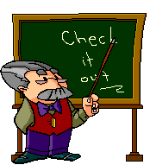
FUTURE SIMPLE
Will/Won’t+V (нач. форма глагола)
I will play… / I’ll play…
He will not read…/He won’t read…
Will they watch?- Yes, they will/No, they won’t.
Tomorrow, the day after tomorrow,
next week/ month / year, tonight,
soon, in a day, in 2 months.

Slide 3


USE:
Прогнозы на будущее, основанные на размышлениях, воображении со словами think, believe, expect, imagine, I’m sure, I hope, I’m afraid, probably, perhaps, maybe.
Maybe, we’ll visit Grandma tomorrow.
I think the weather will be fine.
Oбещания, угрозы
-If you don’t come on time, I’ll go without you.
-I’ll be there at 5 sharp, I promise.
Моментальные решения
-I’m hungry.
–I’ll make you a sandwich.

Slide 4

FUTURE CONTINUOUS
Will+Ving
I will be cooking/I’ll be cooking…
He won’t be sleeping…
Will you be drawing…?-Yes, I will./No, I won’t.
This time tomorrow,
next Sunday at 10 am,
tomorrow from 4 till 6 pm

Slide 5


USE:
Действия, которые будут происходить в определенное время в будущем.
Tom will be writing a test at 3pm tomorrow.
Действия, которые точно произойдут в результате договоренности.
Next Sunday at 11am they’ll be driving to Moscow.
Вежливые вопросы о планах на ближайшее будущее.
-What will you be doing tomorrow at about 7pm?
I’ll be watching a DVD with my friend. Will you join us?
I’d love to.

Slide 6

FUTURE PERFECT
Will+have+Ved/V3
He will have done/He’ll have done…
They won’t have finished…
Will you have written…? –Yes, I will./No, I won’t.
Before, by, by then,
by the time,
until/till

Slide 7

USE:
Действие, которое закончится к определенному моменту в будущем.
They will have bought a house by the end of the year.
She’ll have cooked dinner by 6 pm tomorrow.
После временных выражений the time, until/till, before мы используем Present Simple, т.к. они вводят придаточные предложения.
By the time you arrive, I’ll have cleaned the flat.
He’ll have done his homework before his parents come home.
Как правило, until/till используются в отрицательных предложениях.
Sam won’t have fixed the car until/till this evening.

Slide 8

TO BE GOING TO
to be (am/is/are) going to…
I’m going to read…/He’s going to read…/We’re going to read…
I/m not going to do…/She isn’t going to do…/They aren’t going to do…
Are you going to stay…?- Yes, I am./No, I’m not.
Tomorrow, next Sunday,
soon, in a day, in a week…

Slide 9


USE:
Планы, намерения.
I’m going to travel in summer.
We’re going to visit Grandma next weekend.
Прогнозы на будущее, основанные на фактах.
The sky is dark, it’s going to rain.
I’m in a traffic jam, I’m going to be late again!
Действия, в совершении которых мы почти уверены.
My friends and I are going to play football after school, if we don’t have too much homework.
She’s going to sell her car soon.

Slide 10


Present Continuous/Present Simple
Be (am/is/are) + Ving
I’m driving/He’s driving…
We aren’t going…
Are you meeting…?- Yes, I am./No, I’m not.
V/V3
I go…/He goes…/They go…
We don’t play…/She doesn’t play…
Do you visit…? – Yes, I do./No, I don’t.

Slide 11

USE:
Present Continuous используется для выражения действий, которые точно произойдут в результате договоренности.
We are going to St. Petersburg tomorrow.
What are you doing tonight?
Present Simple используется для выражения действий, происходящих согласно программе, расписанию.
My train to Moscow leaves at 7.15 am.
The show starts at 6pm. Don’t be late!

Slide 12

NOTE
После слов if,while,before,after, as soon as, as,
by the time, when в придаточном предложении
формы будущего времени не используются!
If he is late again, I’ll be very angry.
I’ll have done my homework by the time my
parents come home.
They won’t leave until they finish their work.

Slide 13
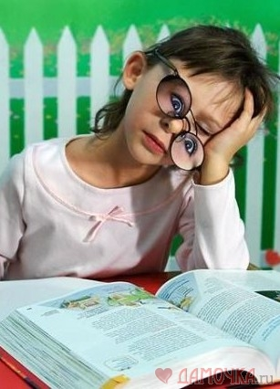
So Much For The Theory!

Slide 14

Let’s Practice!
Explain the use of the tense forms:
1. They are going to play golf this afternoon.
2. By the time you wake up, Mum will have cooked breakfast.
3. Sam’s flying to China in two days.
4. Don’t worry, I’ll help you with your test.
5. Tomorrow at 5pm we’ll be driving to the country.
6. -When does the film start? – At 7.
7. I hope Mike won’t forget to bring his laptop.
8. Sue will have written the essay before her friends come.
9. What will you be doing on Sunday at 2pm?
10. I’m so thirsty! I’ll have a glass of water.

Slide 15

II. Make up sentences using the given words:
the/going/we/country/summer/in/are/to/spend.
We are going to spend summer in the country.
2.you/have/work/the/your/will/show/finished/before/starts?
Will you have finished your work before the show starts?
3.bad/a/if/he/homework/will/do/get/his/doesn’t/he/mark.
If he doesn’t do his homework, he will get a bad mark.
4. are/party/my/throwing/on/friends/a/Saturday .
My friends are throwing a party on Saturday.
5. sea/this/I/be/in/’ll/week/swimming/the/next/time.
This time next week I’ll be swimming in the sea.

Slide 16

III. Put the verbs in brackets in the correct form:
Kate ______________ (paint) the house by 3pm tomorrow.
2. If you can’t do it yourself, I ________ (help) you.
3. Look! That child _____________ (fall)!
4. The Parkers __________ (leave) for Egypt tonight.
5. I _______________ (finish) my composition until late in the evening.
6. Tom _____________ (dance) at the party at 9pm on Saturday.
will have painted
will help
is going to fall
are leaving
won’t have finished
will be dancing

Slide 17
IV. Choose the correct item:
He _______________ to New York this time tomorrow.
2. If Roy _____________ call his girlfriend, she will be angry.
3. What will you have done _________ ____ you leave for school?
4. Mike and Tom have entered the Linguistic University. They ____________ become interpreters.
5. The mechanic ___________________ the car till next Tuesday.
A. is flying
B. will be flying
C. is going to fly
A. won’t
B. don’t
C. doesn’t
A. until
B. by the time
C. after
A. are going to
B. will
C. will be becoming
A. won’t fix
B. will have fixed
C. won’t have fixed

Slide 18

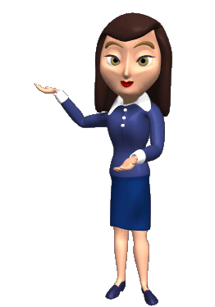

You did well!
Study harder!

Slide 19

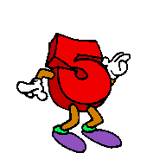

Slide 20
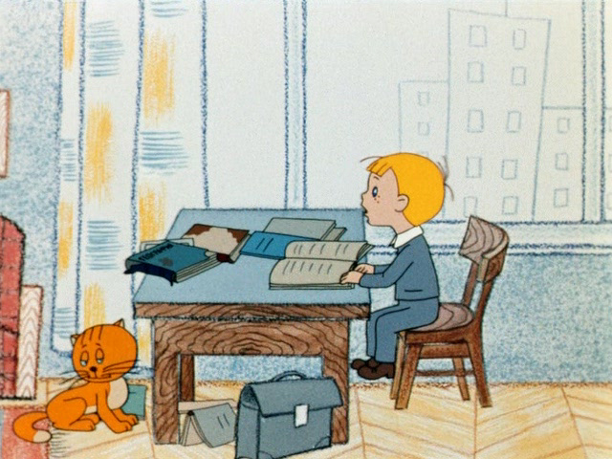

Slide 21



Slide 22

ALL RIGHT!!!

Slide 23

WRONG!!!

